Slide 1



FPT Software
ANDROID TRAINING
LESSON 5
Version 0.1

Slide 2
Agenda
Toast
Dialog
  AlertDialog
  ProgressDialog
  DatePickerDialog
  TimePickerDialog
Dealing with thread
AsyncTask

Slide 3
Toast
A toast notification is a message that pops up on the surface of the window. It only fills the amount of space required for the message and the user's current activity remains visible and interactive.
The notification automatically fades in and out, and does not accept interaction events.

Slide 4
Toast
instantiate a Toast object with one of the makeText() methods.
display the toast notification with show()
  Context context = getApplicationContext();
  CharSequence text = "Hello toast!";
  int duration = Toast.LENGTH_SHORT;
  Toast toast = Toast.makeText(context, text, duration);
  toast.show();

Slide 5
Toast
Positioning your Toast
  change this position with the setGravity(int, int, int) method. This accepts three parameters: a Gravity constant, an x-position offset, and a y-position offset.
    toast.setGravity(Gravity.TOP|Gravity.LEFT, 0, 0);

Slide 6
Toast
Creating a Custom Toast View
  To create a custom layout, define a View layout, in XML or in your application code, and pass the root View object to the setView(View) method.
    LayoutInflater li = getLayoutInflater();
    View v = li.inflate(R.layout.toast_layout, (ViewGroup)findViewById(R.id.my_toast_layout_root));
    Toast t = new Toast(getApplicationContext());
    t.setView(v);
    t.setDuration(Toast.LENGTH_LONG);
    t.setGravity(Gravity.CENTER_VERTICAL, 0, 0);
    t.show();

Slide 7
Dialog
Dialog is usually a small window that appears in front of the current Activity. The underlying Activity loses focus and the dialog accepts all user interaction.
Dialogs are normally used for notifications that should interupt the user and to perform short tasks that directly relate to the application in progress (such as a progress bar or a login prompt).
The Dialog class is the base class for creating dialogs. However, you typically should not instantiate a Dialog directly. Instead, you should use one of the following subclasses:
  AlertDialog
  ProgressDialog
  DatePickerDialog
  TimePickerDialog

Slide 8
Dialog
Activities provide a facility to manage the creation, saving and restoring of dialogs.
  onCreateDialog(int)
  onPrepareDialog(int, Dialog)
  showDialog(int)
  dismissDialog(int)
If you decide to create a dialog outside of the onCreateDialog() method, it will not be attached to an Activity. You can, however, attach it to an Activity with setOwnerActivity(Activity).

Slide 9
AlertDialog
Use it for dialogs that use any of the following features:
  A title
  A text message
  One, two, or three buttons
  A list of selectable items (with optional checkboxes or radio buttons)
To create an AlertDialog, use the AlertDialog.Builder subclass.
Get a Builder with AlertDialog.Builder(Context) and then use the class's public methods to define all of the AlertDialog properties.
Retrieve the AlertDialog object with create().

Slide 10
ProgressDialog
Display a progress animation in the form of a spinning wheel, for a task with progress that's undefined, or a progress bar, for a task that has a defined progression.
The dialog can also provide buttons, such as one to cancel a download.

Slide 11
ProgressDialog
To show the progression with an animated progress bar:
  Initialize the ProgressDialog with the class constructor, ProgressDialog(Context).
  Set the progress style to "STYLE_HORIZONTAL" with setProgressStyle(int) and set any other properties, such as the message.
  When you're ready to show the dialog, call show() or return the ProgressDialog from the onCreateDialog(int) callback.
  You can increment the amount of progress displayed in the bar by calling either setProgress(int) with a value for the total percentage completed so far or incrementProgressBy(int) with an incremental value to add to the total percentage completed so far.

Slide 12
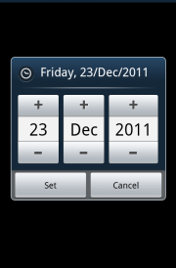
DatePickerDialog
A dialog that prompts the user for the Date using a DatePicker.

Slide 13
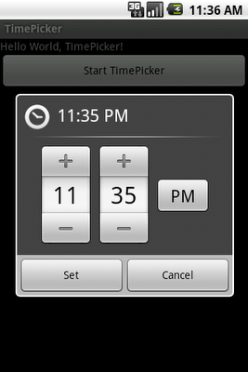
TimePickerDialog
A dialog that prompts the user for the time of day using a TimePicker.

Slide 14
Dealing with thread
When an application is launched, the system creates a thread of execution for the application, called "main." This thread is very important because it is in charge of dispatching events to the appropriate user interface widgets, including drawing events.
Interacts with components from the Android UI toolkit
The main thread is also sometimes called the UI thread.

Slide 15
Dealing with thread
The Andoid UI toolkit is not thread-safe. So, you must not manipulate your UI from a worker thread—you must do all manipulation to your user interface from the UI thread. Thus, there are simply two rules to Android's single thread model:
  Do not block the UI thread
  Do not access the Android UI toolkit from outside the UI thread

Slide 16
Dealing with thread
Android offers several ways to access the UI thread from other threads:
  Activity.runOnUiThread(Runnable)
  View.post(Runnable)
  View.postDelayed(Runnable, long)
  Handler

Slide 17
AsyncTask
AsyncTask simplifies the creation of long-running tasks that need to communicate with the user interface.
The goal of AsyncTask is to take care of thread management for you

Slide 18
AsyncTask
The method doInBackground() executes automatically on a worker thread
onPreExecute(), onPostExecute() and onProgressUpdate() are all invoked on the UI thread
The value returned by doInBackground() is sent to onPostExecute()
You can call publishProgress() at anytime in doInBackground() to execute onProgressUpdate() on the UI thread
You can cancel the task at any time, from any thread

Slide 19
AsyncTask
AsynTask<String, void, String>
Things to note here are:
  1st String represents Params i.e the type of parameter doInBackground method will accept and also represents the type of parameter execute method will accept.
  2nd void represent Progress i.e the parameter type for onProgressUpdate method
  3rd String represents Result i.e the type of parameter accepted by onPostExecute method

Slide 20
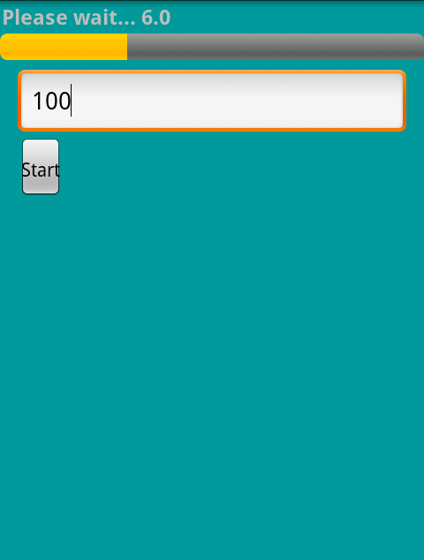
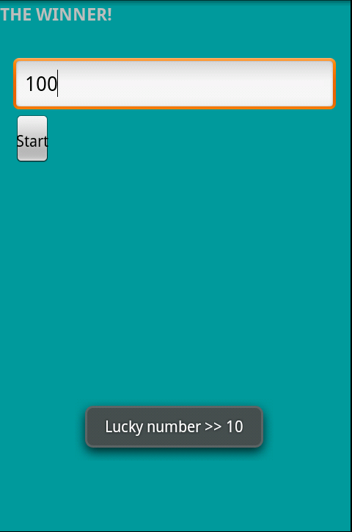
Homework
Create a simple “lucky draw” game

Slide 21
Homework
Start button will start a background thread
The background thread runs in 10 s -> update time left and seekbar on GUI
After 10s, the background thread random 1 number in range on Textbox, alerts message to user

Slide 22
Thank you!

